Slide 1
Lab 5 To Be Process Modeling Analysis
IS210 – Business Process Analysis and Solutioning

Slide 2
Lab Document
Login to eLearn, download and refer to
‘Lab 5 - As Is Process Static Analysis.pdf’

Slide 3
Recap of Lab 4
Sharing Workspace
Import/Export Process Diagram
Settings using Attributes Panel
Quantitative Analysis Report
Generation of Business Process Diagram
Managing attribute visualization layers

Slide 4
Lab 5 - Overview
Recommendations & Rationales
Proposed To-Be Solution Business Process
Estimation and Assumption
Model the To-be Business Process
Quantitative Analysis Report Comparison
Simulation of the To-Be Process - Demo

Slide 5
Part 1 – Recommendations and Rationales
Recommendation 1:
Introduction of a new IT System (Rental Application System, RAS) to process the customer rental application request
Rationale: Root cause [paper-based]
Eliminate Dispatch form to MO by OD
Customer request can be routed to MO via RAS together with an email notification and SMS to inform of routed request

Slide 6
Part 1 – Recommendations and Rationales
Recommendation 2:
Enterprise integration of RAS (from recommendation 1) and existing application IMS
Rationale: Root cause [paper-based]
Integration helps in effective reuse of existing systems.
Integrate the new IT rental application (RAS) with the existing IMS to facilitate automatic retrieval of available choice industrial space
MO will just need to review the choices retrieved.
MO to update customer selection in RAS. RAS will automate the update in IMS

Slide 7
Part 1 – Recommendations and Rationales
Recommendation 3:
Begin rental application process with the UEN check of eligibility by CSO before gathering requirements
Rationale: Root cause [Late exception checking]
There is a 25% probability that customers are not eligible for rental application after the UEN check.
By checking the eligibility first, we can save on resource (human) wastage and customers can be informed immediately if they are not eligible.
Minor change of roles’ responsibilities

Slide 8
Part 2 – Proposed To Be Solution Business Process
To Be Solution: Implement recommendation 1, 2 and 3
Recommendation 1: Introduction of a new IT system (Rental Application System, RAS) to process the customer rental application request
Recommendation 2: Enterprise Integration with new RAS & existing application IMS
Recommendation 3: Begin rental application process with the UEN check of eligibility by CSO before gathering requirements
Rationale
Implement technology improvements together with a process flow change

Slide 9
Part 3 – Estimation and Assumption (Proposed To-Be Solution Business Process)
Cur Step | Prev Step | Task Description | Execution Time (min) | Role | Resource
1 | - | CSO obtains customer’s UEN and verifies eligibility | 7 | CSO | UEN website
2 | 1 | CSO gathers requirements and updates RAS | 20 | CSO | RAS
3 | 1 | CSO informs customer of application rejection and updates RAS. Process ends | 5 | CSO | RAS
4 | 2 | RAS matches request with IMS | 5 | RAS | IMS
5 | 4 | RAS emails and SMS MO of request | 1 | RAS
6 | 5 | MO reads email from RAS & proceeds to CSC to meet customer | 5 | MO
7 | 6 | MO reviews and markets choice industrial spaces retrieved by RAS to customer | 35 | MO | RAS
8 | 7 | MO reserves customer’s selection in RAS | 3 | MO | RAS
9 | 7 | MO updates RAS of customer’s rejection. Process ends | 1 | MO | RAS
10 | 8 | RAS sends email to LM for application approval & updates IMS with customer’s selection | 1 | RAS | IMS
11 | 8 | CSO collects booking fee from customer. CSO updates RAS of booking payment and print receipt for customer via RAS. Process ends | 12 | CSO | RAS

Slide 10
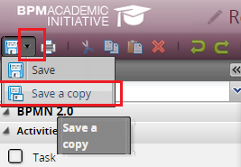
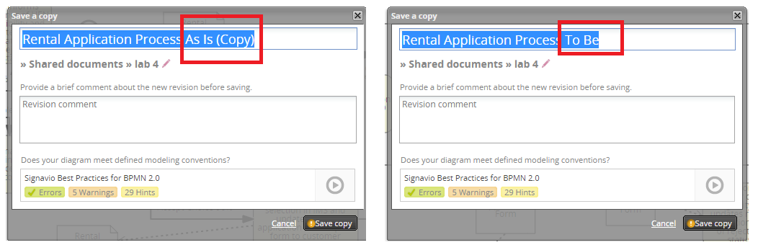
Part 4 – Model the To-Be Business Process
Using Save a copy from the Process Editor
Rename diagram as “Rental Application Process – To Be”

Slide 11
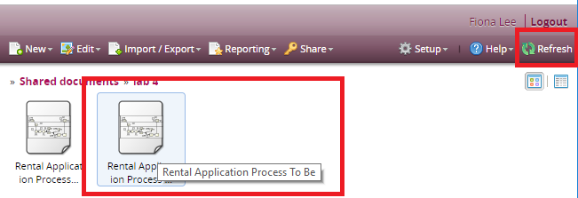
Part 4 – Model the To-Be Business Process
Return to the Explorer View
Click “Refresh” to view the new process diagram

Slide 12
Part 5 – Quantitative Analysis Report Comparison
Cost Analysis
Resource cost, Activity Cost, Process Cost
Resource Planning Analysis
Resource utilization, Activity Time, Process Cycle Time
Bottleneck Analysis
Path Analysis

Slide 13
Part 5 – Simulation of the To-Be Business Process - Demo
Simulation allows you
Observe the performance of business process
Reveal any bottlenecks, redundancies or waste

Slide 14
Part 5 – Simulation of the To-Be Business Process - Demo
Three Different Simulation Modes
Step by Step Simulation
One Case Simulation ( Demonstration )
Multiple Cases Simulation ( Demonstration )

Slide 15
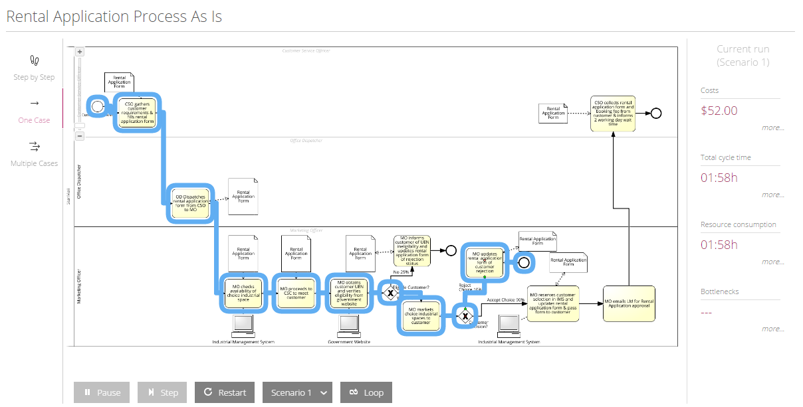
Part 5 – Simulation of the To-Be Business Process - Demo
One Case Simulation

Slide 16
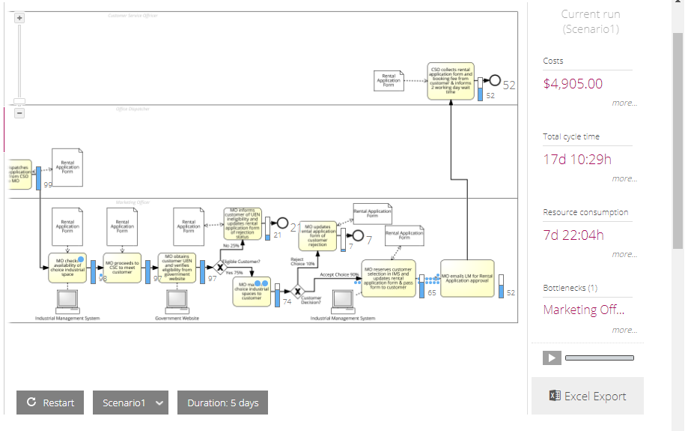
Part 5 – Simulation of the To-Be Business Process - Demo
Multiple Cases Simulation

Slide 17
Part 5 – Simulation of the To-Be Business Process - Demo
Multiple Cases Simulation
Timetables
Define availability and cost schedules of resources, roles and task
Resources may only be available during specific times of the day
Cost of using this resources depends on the time of the day, or year that is used.

